Slide 1
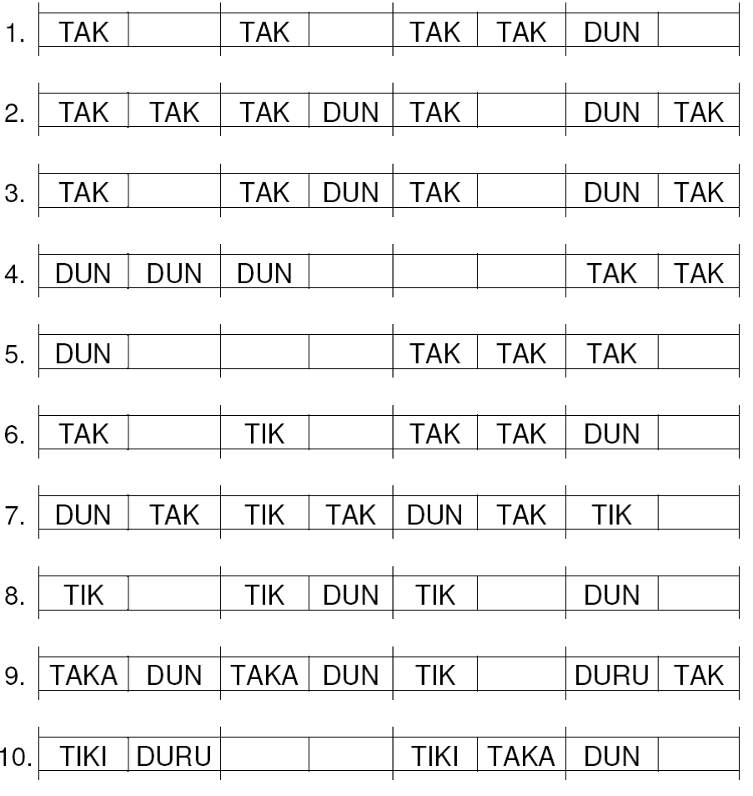
Activity 2
Source:
Reiter G. (1998). Body Percussion. Innsbruck (Austria): Helbling Verlag
First graders will read, even when they don't know the letters.
> Pupils become collaborators of the teacher and entrepreneurs of their own learning.
Mathe macht Musik, Markus Cslovjecsek

Slide 2
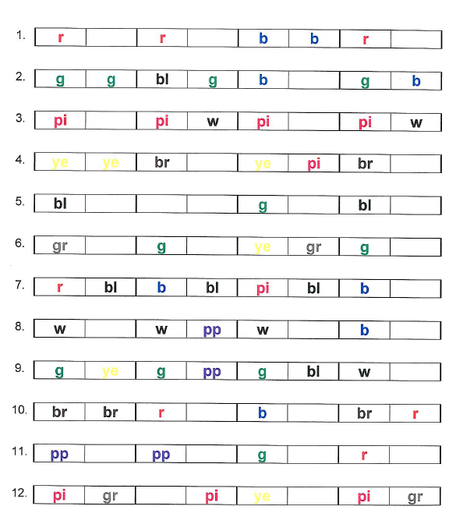
example 2a
development along pupils ideas
Adaption 1: colours
Mathe macht Musik, Markus Cslovjecsek

Slide 3
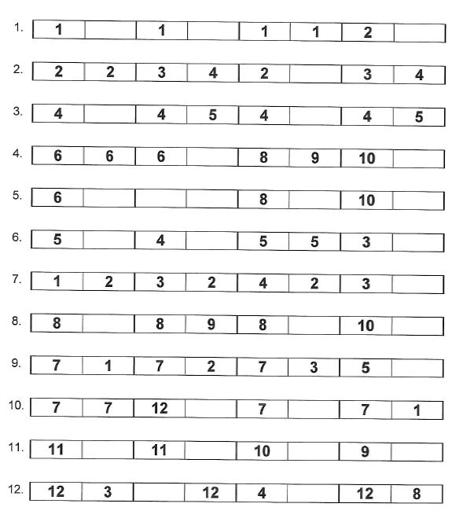
example 2b
development along pupils ideas
Adaption 2: numbers
Mathe macht Musik, Markus Cslovjecsek

Slide 4
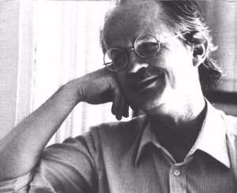
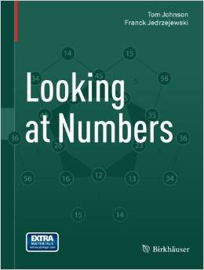
Tom Johnson is a composer who uses logic and mathematical models, such as combinatorics of numbers, in his music. The patterns he finds while “looking at numbers” can also be explored in drawings. This book focuses on such drawings, their beauty and their mathematical meaning. The accompanying comments were written in collaboration with the mathematician Franck Jedrzejewski.

